Slide 1

Model Context Protocol
Making AI Smarter with External Data

Slide 2
Agenda
Introduction to MCP
What is the Model Context Protocol?
Why it matters for AI
The Integration Problem
Before MCP: Fragmented connections
After MCP: Unified standard
MCP Architecture
Three key components: Host, Client, Server
Communication flow and data pipeline
Technical Foundation
JSON-RPC 2.0 protocol
Transport mechanisms (stdio, HTTP+SSE)
MCP Capabilities
Resources, Tools, and Prompts
Real-world MCP servers
MCP vs Traditional APIs
Key differences and when to use each
Benefits and challenges
Implementation Examples
Code samples and configuration
Conclusion and Future

Slide 3
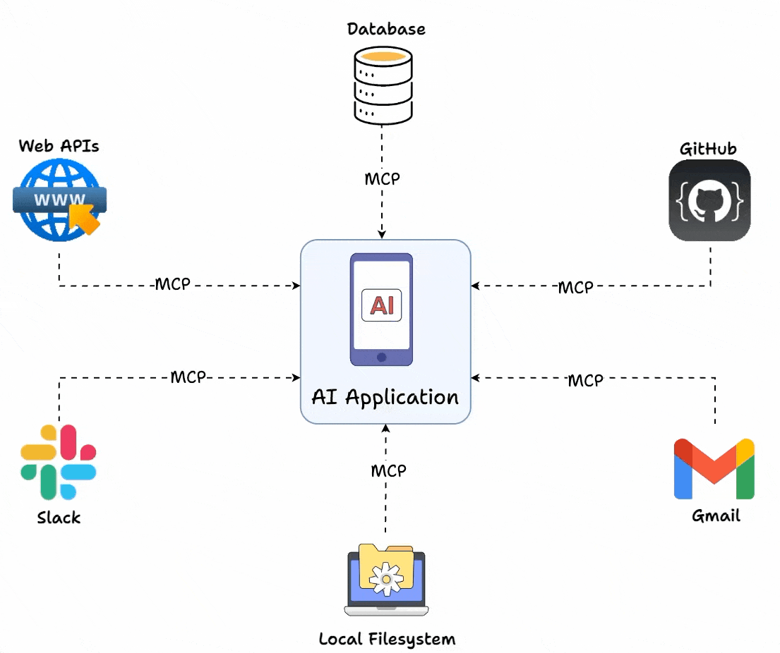
What is MCP?
Model - Large Language Models (LLMs) like Claude, ChatGPT
Context - External information: files, databases, APIs, real-time data
Protocol - Standardized communication rules between systems

Slide 4
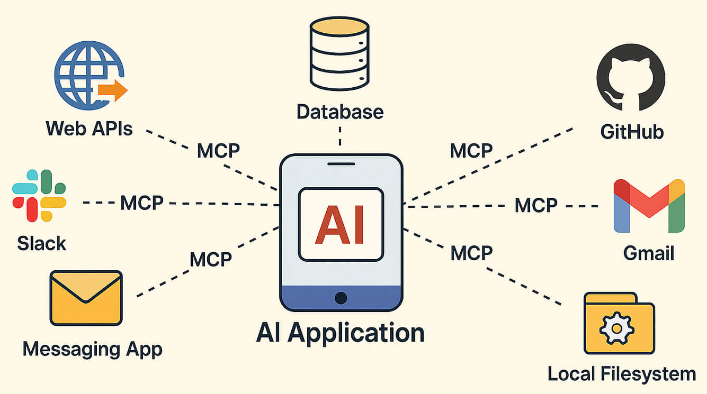
What is MCP?
MCP is an open standard released by Anthropic in November 2024
Enables AI assistants to securely connect to external data sources
Think of it as USB-C for AI: one standard port for all connections
Eliminates need for custom integration code for each data source

Slide 5
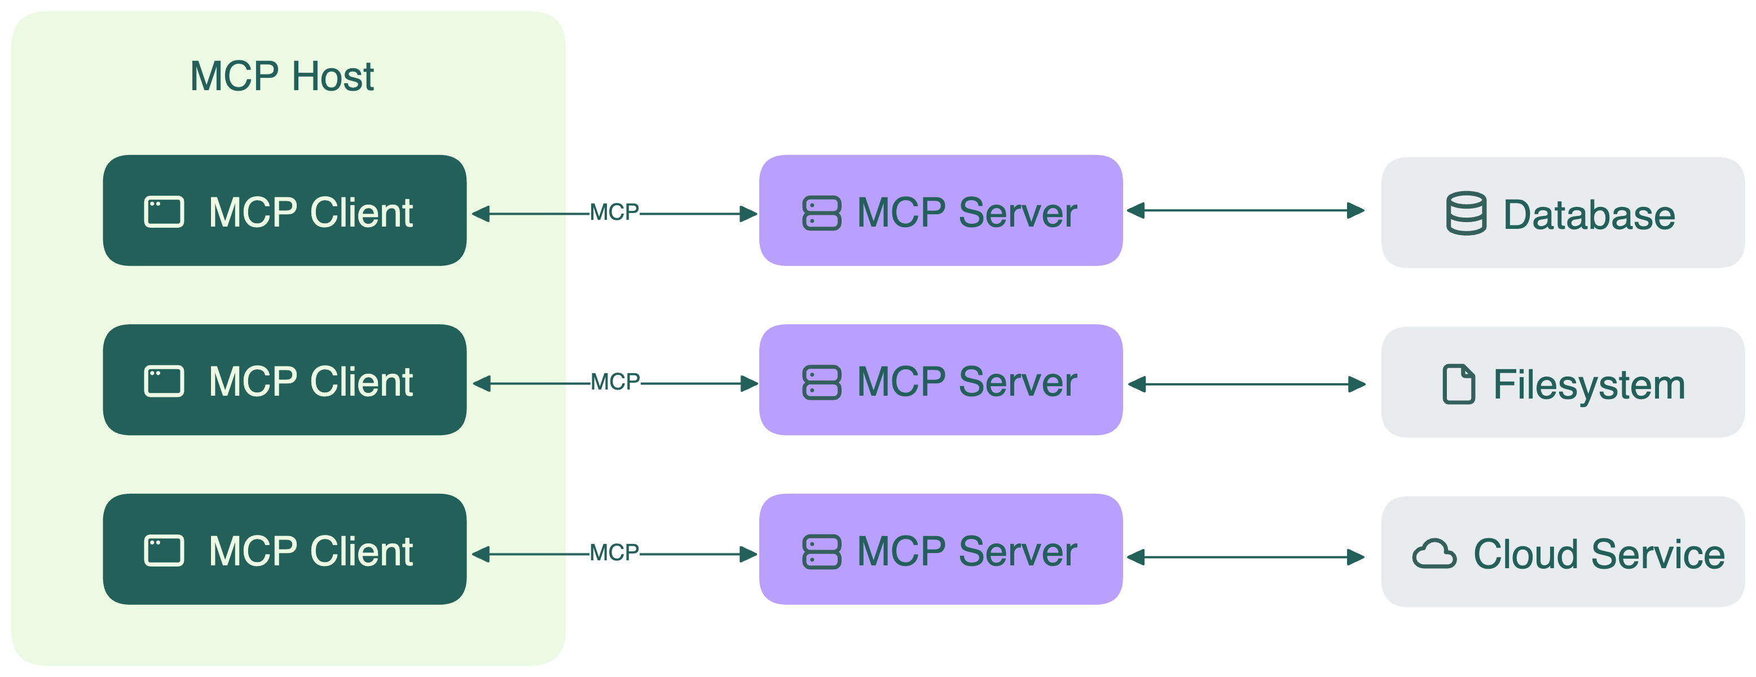
MCP Components
Host - The AI application (Claude Desktop, Cursor, VS Code)
  Manages client lifecycle and security policies
  Integrates with LLM for reasoning and responses
Client - MCP protocol implementation within the host
  Maintains stateful connection to servers
  Handles capability negotiation and message routing
Server - External program exposing capabilities
  Provides resources (data), tools (actions), prompts (templates)
  Examples: GitHub, Slack, database connectors

Slide 6
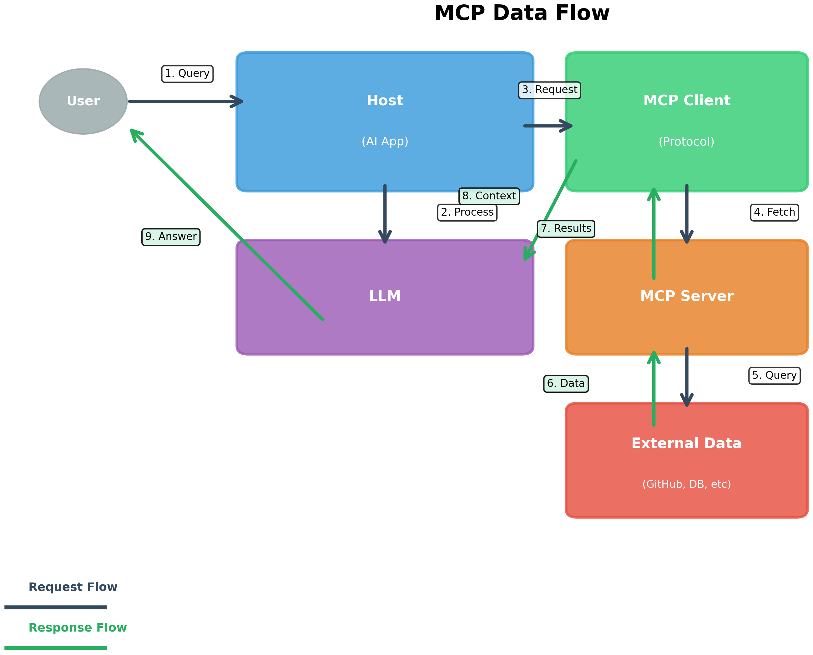
MCP Architecture
Client-server architecture
Host contains AI application
Client handles protocol communication
Server exposes capabilities
Secure, bidirectional messaging
Stateful session management

Slide 7
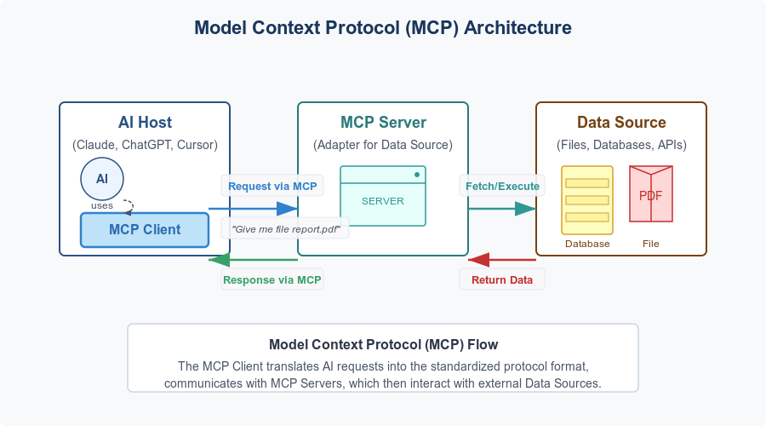

Slide 8
Communication Flow
User sends query to Host
Host forwards to LLM for processing
LLM determines needed capabilities
Host requests tools from Client
Client queries available tools from Server
Server returns tool list and data
Client sends results to LLM
LLM generates informed response
User receives contextual answer

Slide 9
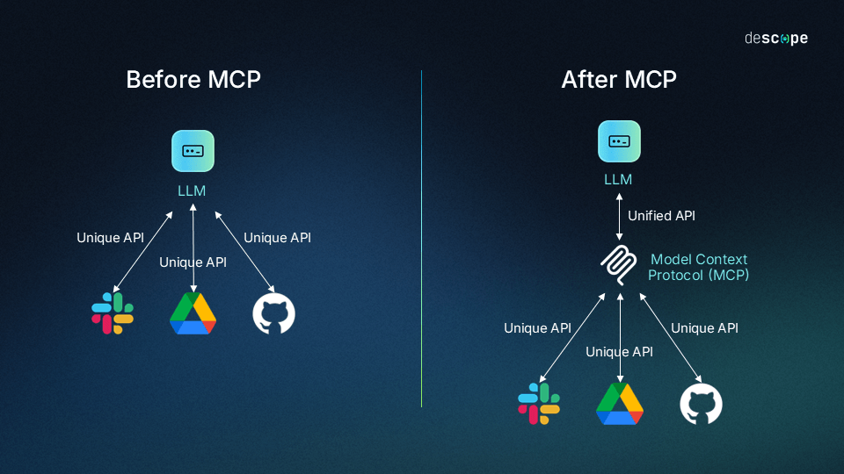
The Problem: Before MCP
AI models isolated from real data
Each integration requires custom code
M × N problem: M apps × N data sources
Hard to maintain and scale
Time-consuming development
Fragmented and brittle connections

Slide 10
The Solution: After MCP
One standard protocol for all integrations
M + N problem: Each implements protocol once
Plug-and-play connectivity
Reduced development time by 70%+
Single codebase works across all AI systems
Easier to maintain and upgrade
Open source and community-driven

Slide 11
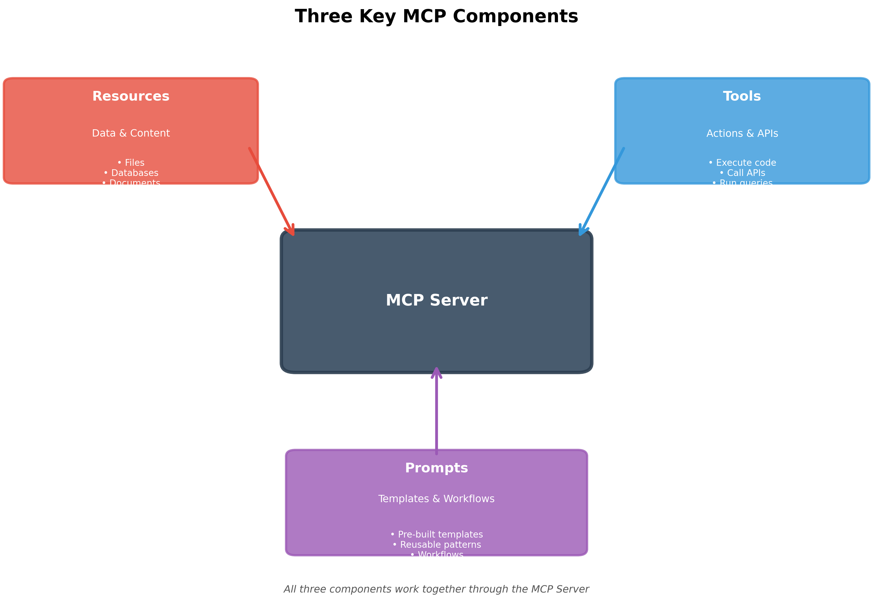
Three Key MCP Capabilities
Resources - Read-only data access. Files, database records, API responses
Tools - Actions AI can perform. Execute code, send emails, run queries
Prompts - Reusable templates. Pre-built workflows and instructions
Resources, Tools, and Prompts are capability types that an MCP server exposes to an MCP client

Slide 12
Resources (Read-only Data Access)
Think of resources as things you can look at but not change.
They’re pieces of information your AI (or MCP client) can read — like:
A document file
A database record
A JSON API response
👉 The AI can fetch or read this data through the MCP server, but it can’t modify it.
Example:
Reading a CSV file or fetching today’s weather data from an API.

Slide 13
Tools → “Actions AI can perform”
Tools are actions that the AI can take — they actually do things.
Each tool is like a function or command the MCP client can call.
They can:
Execute code
Send an email
Run a database query
Start a workflow or script
👉 Tools are active, meaning they let the AI change or create things in the world.
Example:
A tool called send_email that takes to, subject, and body parameters.

Slide 14
Prompts → “Reusable templates”
Prompts are predefined instruction sets that can be sent to or requested from a model. They are templates that can be reused — sort of like macros or mini workflows.
They often include:
  Structured instructions for how to respond
  Context about what to do
  Optional variables you can fill in
👉 Prompts make it easy to repeat common reasoning or formatting tasks.
Example:
A “summarize_document” prompt template that says:
“Summarize the following text in under 100 words focusing on key facts.”

Slide 15
MCP Capability Types
MCP Component | What it Does | Analogy
Resources | Read data | A bookshelf 📚
Tools | Take actions | A toolbox 🧰
Prompts | Provide reusable instructions | A recipe book 🍳
These capabilities represent what kinds of things the MCP client can ask the MCP server to do or access.

Slide 16
MCP Request Types (JSON-RPC Methods)
Method | Purpose
initialize | Establish the connection and handshake
resources.list | Discover available resources
resources.read | Read the content of a resource
tools.list | Discover what tools are available
tools.call | Execute a tool
prompts.list | List available prompts
prompts.execute | Run a prompt template
notifications (optional) | Send one-way updates like logs or progress info

Slide 17
Technical Foundation: JSON-RPC
MCP uses JSON-RPC 2.0 as message format
Lightweight, language-agnostic protocol
Three message types:
Request - Method call with parameters
Response - Result or error from server
Notification - One-way message without response
All messages include: jsonrpc=2.0, method, id, params

Slide 18
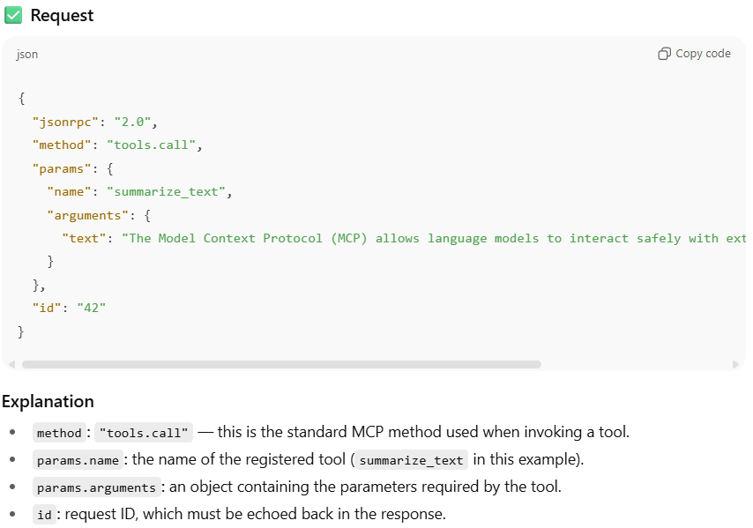
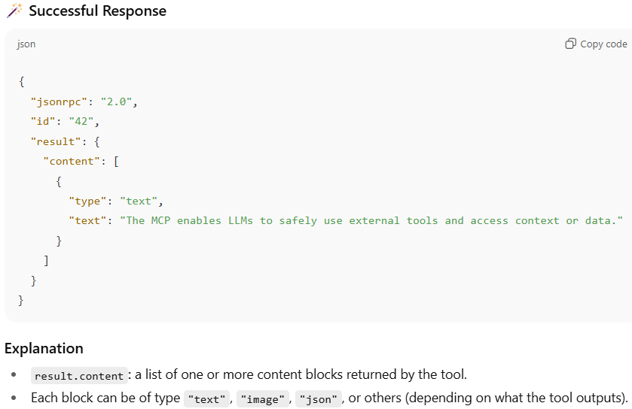
JSON-RPC 2.0 Message Examples
Here is an example showing how a MCP client calls a tool using JSON-RPC 2.0.
The JSON-RPC 2.0 response is returned by the MCP server to the MCP client.

Slide 19
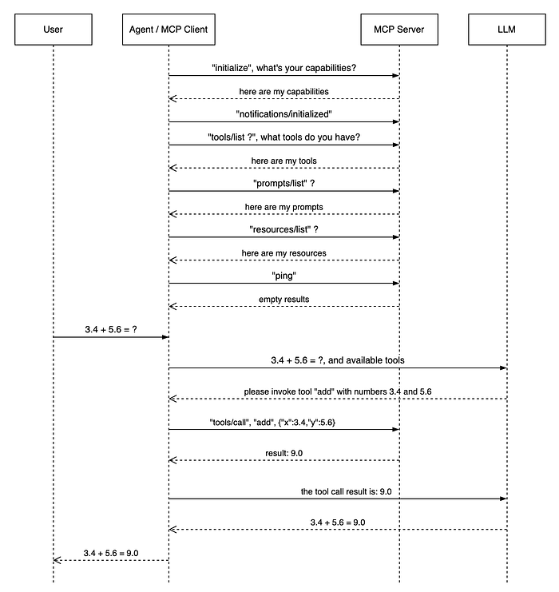
MCP Client-Server Communication
LLM: The language model that processes natural language and generates responses
Agent/MCP Host: The application layer that orchestrates LLM interactions and manages MCP connections
MCP Client: The component within the agent that communicates with MCP servers. Usually, it runs on MCP Host.
MCP Server: External services that provide tools, resources, and capabilities. These services are running outside of the Agent process. They can be on local or remote host

Slide 20
Interactive MCP Demo - Model Context Protocol

Slide 21
Transport Mechanisms
stdio (Standard Input/Output)
  For local communication on same machine
  Server runs as subprocess
  Uses stdin/stdout for messages
  Simple, no network configuration needed
HTTP with Server-Sent Events (SSE)
  For remote communication over network
  Client sends POST requests to server
  Server pushes updates via SSE
  Supports cloud deployments and scaling

Slide 22
stdio Transport
Use Case: Local tools (filesystem, local DB, scripts)
How it works:
  Host launches server as child process
  Messages written to stdin (newline-delimited JSON)
  Responses read from stdout
  Errors/logs written to stderr
Advantages:
  Simple implementation, no network overhead
  Secure: OS-level process isolation
  Perfect for development and local tools

Slide 23
HTTP+SSE Transport
Use Case: Remote services, cloud APIs, multi-user systems
How it works:
  Client makes HTTP POST for requests
  Server responds with JSON or opens SSE stream
  Persistent connection for real-time updates
Advantages:
  Scalable across networks
  Works through firewalls and proxies
  Supports distributed architectures
  Session management with Mcp-Session-Id header

Slide 24
Popular MCP Servers - Development
Filesystem Server
Read/write files, create directories, search
GitHub Server
Repository management, file operations, PR creation
Slack Server
Channel management, messaging, search history
Google Drive Server
File access, search, sharing capabilities
SQLite/PostgreSQL Server
Database queries, schema inspection, data analysis

Slide 25
Popular MCP Servers - Integration
Puppeteer Server
Browser automation and web scraping
Git Server
Repository manipulation, commit history, branching
Memory Server
Simple key-value store for context persistence
Weather API Server
Real-time weather data and forecasts
Docker Server
Container management, image operations

Slide 26
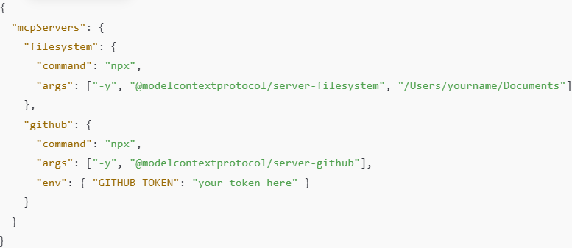
MCP Configuration Example
Configuration in Claude Desktop (JSON).
This config tells Claude Desktop which MCP servers to connect to and how.
Each entry under "mcpServers” defines a service that Claude can talk to using the Model Context Protocol — a standard way for AI clients (like Claude or others) to connect to external tools, data sources, or APIs.
Essentially, this config registers plugins or connectors the AI can use through MCP.
When Claude Desktop starts up and reads that JSON, it sees:
“There’s an MCP server named filesystem that I can connect to by running npx -y @modelcontextprotocol/server-filesystem /Users/yourname/Documents.”
So the client — Claude Desktop — launches that command as a subprocess on your machine.
In other words:
The client starts the MCP server for you.
The MCP server process then begins running locally, listening for requests (usually via stdin/stdout, or sometimes a socket).

Slide 27
MCP vs APIs: Key Differences (1)
Discovery:
  API: Static, requires documentation reading
  MCP: Dynamic, tools list available at runtime
Standardization:
  API: Each API has unique format and auth
  MCP: Uniform protocol across all servers
Integration:
  API: Custom code for each integration
  MCP: Write protocol once, connect to any server

Slide 28
MCP vs APIs: Key Differences (2)
Context Management:
  API: Stateless, context passed in each request
  MCP: Stateful sessions, maintains context
AI Integration:
  API: LLM must know exact endpoints/parameters
  MCP: LLM discovers capabilities dynamically
Flexibility:
  API: Changes break client implementations
  MCP: Backward compatible, graceful degradation

Slide 29
When to Use MCP vs APIs
Use MCP when:
Building AI agents that need tool access
Requirements evolve frequently
Need AI to dynamically discover capabilities
Connecting AI to multiple data sources
Use Traditional APIs when:
Need maximum performance (high throughput)
Deterministic machine-to-machine communication
Non-AI clients or static integrations
Use Both when:
APIs for core infrastructure, MCP for AI layer

Slide 30
Benefits of MCP
Reduced Development Time
70%+ faster integration vs custom code
Write once, deploy everywhere
Improved Maintainability
Single protocol to learn and maintain
Easier updates and debugging
Enhanced AI Capabilities
AI can discover and use new tools automatically
Better context awareness and memory
Scalability
Add new servers without modifying clients
Growing ecosystem of pre-built servers

Slide 31
Challenges and Considerations
Security Concerns
Agents have significant autonomy
Need proper access controls and validation
Performance Overhead
Additional protocol layer adds latency
Not ideal for high-frequency operations
Learning Curve
New paradigm for developers
Requires understanding stateful sessions
Ecosystem Maturity
Still evolving (launched Nov 2024)
Limited tooling compared to REST APIs

Slide 32
Real-World Use Case
Customer Support AI Agent:
Query customer data from CRM (Salesforce MCP)
Search internal docs (Google Drive MCP)
Check order status (Database MCP)
Send follow-up email (Gmail MCP)
Create support ticket if needed (Jira MCP)
All from single conversational interface
Result:
30% faster response time
Reduced manual lookups by 80%
Better customer satisfaction

Slide 33
Simple Implementation
Building a simple MCP Server (Python):
Install: pip install mcp
Define server with tools:
  server = Server("my-server")
  @server.list_tools()
  async def handle_list_tools():
  return [Tool(name="search", ...
Implement tool handlers
Run: python -m mcp.server.stdio
Building takes minutes, not days!
Full SDK available for TypeScript and Python

Slide 34
Industry Adoption
Major Adopters:
Anthropic (Claude) - Creator and primary supporter
Cursor, Cline, Windsurf - AI coding assistants
AWS, Google, Microsoft - Cloud providers
Replit, Zed, Sourcegraph - Development tools
Block, Apollo - Enterprise implementations
Growing Ecosystem:
500+ community MCP servers
Official servers for major platforms
Active GitHub community (9,000+ stars)
Rapid adoption in Q1 2025

Slide 35
The Future of MCP
Expected Evolution:
Better performance optimization
Enhanced security and governance tools
More pre-built enterprise servers
Improved observability and debugging
Market Impact:
MCP becoming standard like HTTP/REST
Reduced cost of AI integration
Faster AI product development
More powerful AI agents
Potential to transform how AI connects to world

Slide 36
Key Takeaways
MCP is the USB-C standard for AI systems
Solves M×N integration problem with M+N solution
Uses JSON-RPC 2.0 over stdio or HTTP+SSE
Three capabilities: Resources, Tools, Prompts
Complements APIs, doesn't replace them
Already adopted by major tech companies
Reduces development time by 70%+
Growing ecosystem with 500+ servers
Best for AI agents needing dynamic tool access
The future standard for AI-data integration

Slide 37
Getting Started with MCP
For Student:
Read docs: modelcontextprotocol.io
Try Claude Desktop with MCP servers
Explore GitHub: github.com/modelcontextprotocol
Join community discussions
For Developers:
Install MCP SDK (npm or pip)
Build simple server (filesystem, API wrapper)
Test with MCP Inspector tool
Contribute to open-source servers
Resources:
Official documentation, tutorials, examples
Awesome MCP Servers list on GitHub

